Slide 1

Alpha Evolution

Slide 2
Trading is a difficult business
Between 70% and 90% of retail investors lose money when trading;
  it is not a given that ML can deal with the problem;
But simple models produce good returns
  buy S&P on dips, receive rates on spikes, buy USD, wear diamonds. Will this still work going forward?
    These models work well for a few assets but will fail miserably on others, if it were only possible to determine ex-ante which features make an asset a good candidate...
  Long equities at the turn of the month
    this one captures a market inefficiency, therefore, is it maybe more likely to persist?

Slide 3
Validating such a model is a difficult business
Even if a model performs well in back-testing across several assets for a long period of time, there is no assurance that future performance will match that observed in back-testing – including training and cross-validation periods;
It is hard to gather data on different assets covering several market cycles;
  Since 1999, the S&P experienced only 2 bear markets;
  Therefore, training on “only” 20y of data might not be enough

Slide 4
Systematic vs Discretionary
A discretionary PM can place large trades on value/convex propositions:
  Buy stock of a “great” company at fire-sale price;
  Buy option structures with extreme asymmetric payoffs
    Call spreads on USD/HKD;
  Buy “almost-free” options
It is tricky for an algo to identify such “excellent” trades systematically
  How to create a rule to identify a “great” company?
  How to identify the optionalities embedded in a trade?
Algo traders need to find small edges that persist through time, instead
  The tricky bit is that such edges might appear, disappear and re-appear without notice

Slide 5
AlphaEvolution value proposition
A platform to enable quick development and backtesting of sophisticated strategies;
Assesses a strategy likelihood of not being spurious;
Flexible enough to integrate new data sources, indicators or models and allowing strategies to evolve thru time;
Prevent forward looking bias via AI;
New data/indicators predictive power, relationship with market variables are tested and new rules are created automatically.

Slide 6
A typical strategy in AE will combine
  Time-series analysis:
    Multi-timeframe;
    Technical indicators;
    Candle patterns;
    Mean reversion;
    HMMs
  Macro analysis:
    US, Europe, China economic activity/inflation;
    Fed, ECB, PBOC monetary stance;
    PMIs;
    Economic surprise indices;
    Financial conditions indices;
    Current activity / Leading indicators;
    Rates differentials;
    REER.
    Cross-section analysis
      VAR/VECR models;
      Vs S&P500, VIX, UST, DXY;
      Vs peers, drivers;
      Vs overall market principal components.

Slide 7
Single-strategy Workflow
Feature extraction step:
  Datasets are loaded from numerous sources
    Online or offline for training;
  Different features are loaded or computed on the fly;
Aggregation step:
  Datasets with different timeframes are combined;
Prediction step:
  Rules are applied based on the selected features;
Evaluation step:
  Data is automatically labeled based on rules
    Entry/exit logic
    Return up to X steps ahead
  Several stats are computed, among them:
    Number of trades, hit ratio, sharpe, etc
    Likelihood of not being spurious – here called “robustness”
    Likelihood of forward looking bias

Slide 8

Single-strategy Workflow
Serial signals removed
&
Trades simulated using entry/exit logic
&
Strategy stats computed
Data Loaded
&
Features extracted
&
Timeframes Aggregated
Predictions generated by individual rules
&
Predictions aggregated into buy/sell signals

Slide 9
Overall strategy
Overall Strategy workflow:
  Each strategy produces its own signals;
  Trades are weighted taking into account the track record of the strategy that generated it;
Tournament:
  strategies compete with each other and those with better scores are given a shot;
  strategies that do not make the cut are still kept in the pool and might re-surface at a different point in time, provided it generates consistent results for some period and its results are not deemed spurious.
Recombination:
  New strategies are created by:
    Re-combining the building blocks of existing strategies;
    Adding new indicators from new data sources;
    Adding new features computed off existing data.

Slide 10
Appendix
Implementation

Slide 11
Inputs
Price data – bars (open, high, low, close, volume)
  Oanda or different brokers
  Different timeframes – offline, we use only one timeframe to reconstruct the higher timeframe bars
Any relevant data
  Weather
  Calendar information
    end of month,
    futures expiries,
  Macro data:
    Saved in csv files (scraped from web) or manually downloaded;
    Loaded from different websites thru their APIs, eg.: FRED
  Flows data

Slide 12
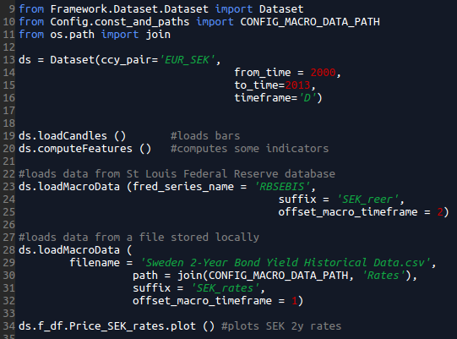
Loading data (simple_data_read.py)

Slide 13
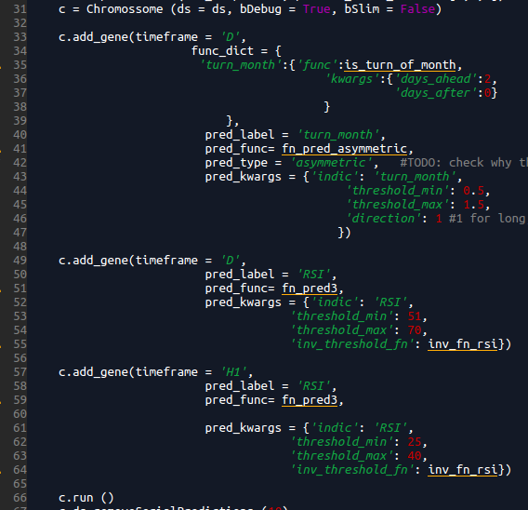
Rules to generate entry signals
Rules based on different indicators are encoded in genes;
A chromossome is an object containing several genes encoding a complex trading rule that generates buy and sell signals.

Slide 14
Types of Genes
Symmetric: basic type of gene, buy if a condition is met, sell if its opposite is true. Eg.: buy when RSI_D < 30, sell when RSI_D > 70;
Asymmetric: buy only or sell only indicator. When added to a chromossome, the whole chromossome becomes one-sided. Need to be careful when evaluating the strategy to compare to an appropriate benchmark;
Binary: generates a signal that needs to be active for buying as well as for selling, otherwise, neither buying nor selling will happen. Eg.:
  realized vol above a minimum threshold,
  timeseries showing trend stationarity instead of constant;
Preventer: can prevent buying/selling or both when active. Eg.: not buy if RSI_W > 70 or not buy/sell when NFP is approaching.

Slide 15
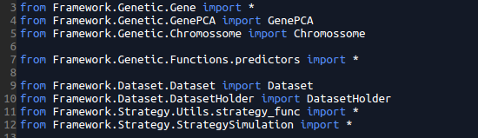
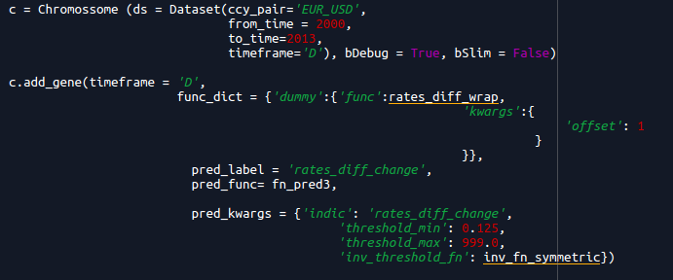
Simple chromossome (macro_data_gene.py)

Slide 16
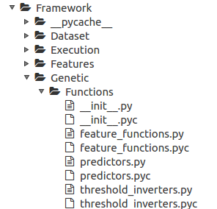
Auxiliary functions – part of genes
Feature Functions
feature_functions: wrappers to create new features,
All share same signature:
  fn_bla_bla (ds, **kwargs)
Kwargs is a dictionary with parameters,
examples:
  rates_diff_wrap
  load_macro_data_wrap

Slide 17
Auxiliary functions – part of genes
Predictors (optional)
Predictors: functions to generate signals based on one or more features,
All share same signature:
  fn_predXX (ds, **kwargs)
Kwargs is a dictionary with parameters,
examples:
  fn_pred_preventer: used in preventer genes, ie, if a condition is met, do not buy (but ok to sell) or do not sell (ok to buy);
  fn_pred_asymmetric: used in asymmetric genes, ie, buy only/sell only;
  fn_pred3: used in symmetric genes, buy if an indicator is within a range, sell if the indicator or its dual is within the inverse of this range;
  fn_pred_double: same as fn_pred3 but uses two indicators to generate the predictions;
  These output discrete values: NEUTRAL_SIGNAL, LONG_SIGNAL, SHORT_SIGNAL;
  In the future, there could be more values or even continuous predictions, but could otherwise just plug in the feature in some model like SVM.

Slide 18
Auxiliary functions – part of genes
Threshold inverters (optional)
This is low level information but just for one to have a complete view and not to be intimidated by the code,
Rules are encoded in a gene from the perspective of who is looking to buy (except in the case of asymmetric genes). Eg.: buy if RSI < 30 on a daily timeframe;
However, if the rule is symmetric it should also work for selling. In this case, it should sell if RSI > 70;
In other cases, the indicator has values distributed around 0 or 100. Therefore, we need a function to invert the thresholds used for buy signals in order to compute sell signals.

Slide 19
Trade simulation
Once signals are generated – and possibly filtered, in order to remove serial predictions – a separate logic handles the entry and exit decisions in order to maximize profits/minimize losses of the strategy;
There are 4 basic components of this logic:
  Entry trigger: conditions to trigger the entry on a trade after a signal has been generated – default: buy/sell at the next open;
  Stop/target initialization: set-up the initial stop and target prices;
  Stop/target updating: update stop/target based on new information;
  Force exit: conditions that trigger an immediate trade exit – eg.: reversal patterns, overbought/sold conditions.

